Slide 1
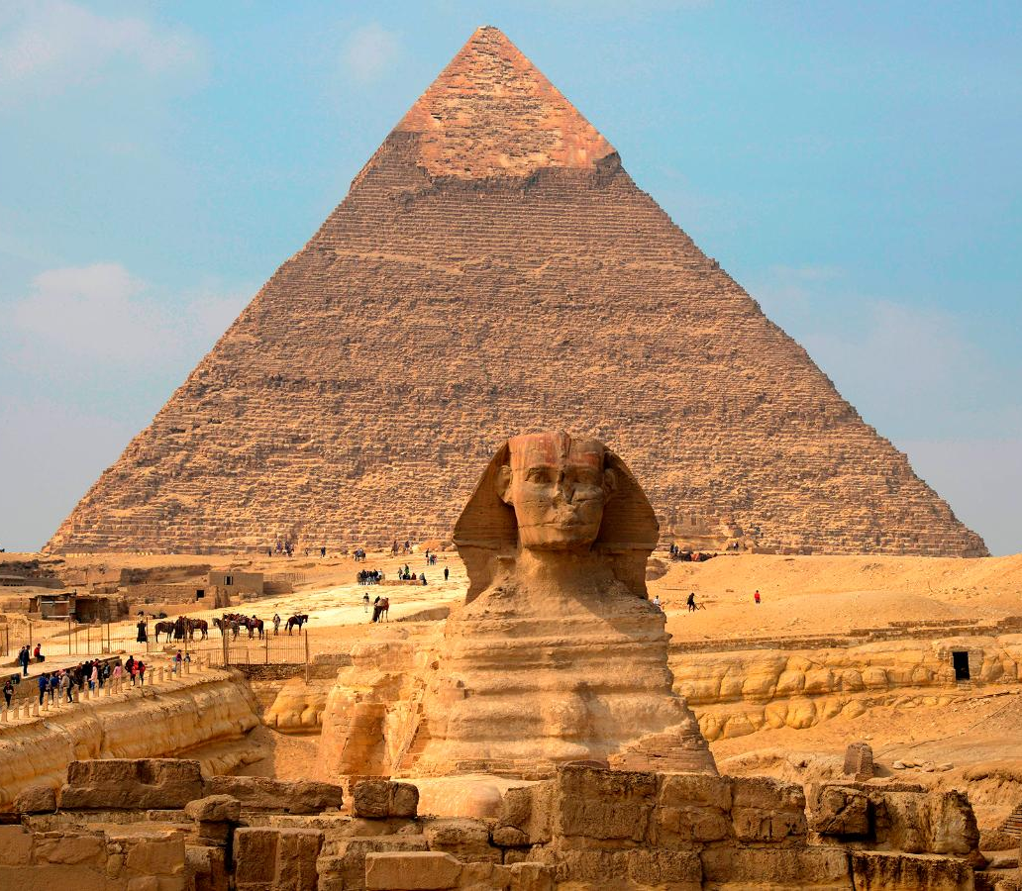
Hieroglyphs
GOAL/S: Write using hieroglyphs
Week 7, Lesson 3

Slide 2
What are ‘Hieroglyphs’?
Egyptian hieroglyphs or literally “sacred carvings” were in use before 3100 BCE.
They developed from pictures of objects or things (pictographs), and they always retained their pictorial form.
Pictographs are simple drawings of objects that prehistoric peoples knew and saw around them, which they used as symbols to represent the words for the objects in their particular language.
Phonograms are “sound signs” that represent the individual sounds which make up the words in a language.
The Egyptian “alphabet” are pictographs that function as phonograms.

Slide 3
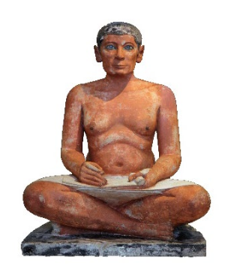
Scribes
Scribes were ancient Egyptian writers and carvers serving as administrators, tax gatherers and accountants. They had a high status in society and directed and supervised many others. Their duties included:
Imposition and collection of taxes
Keeping accounts
Keeping army records
Controlling the law courts
Composing and copying religious and other texts

Slide 4
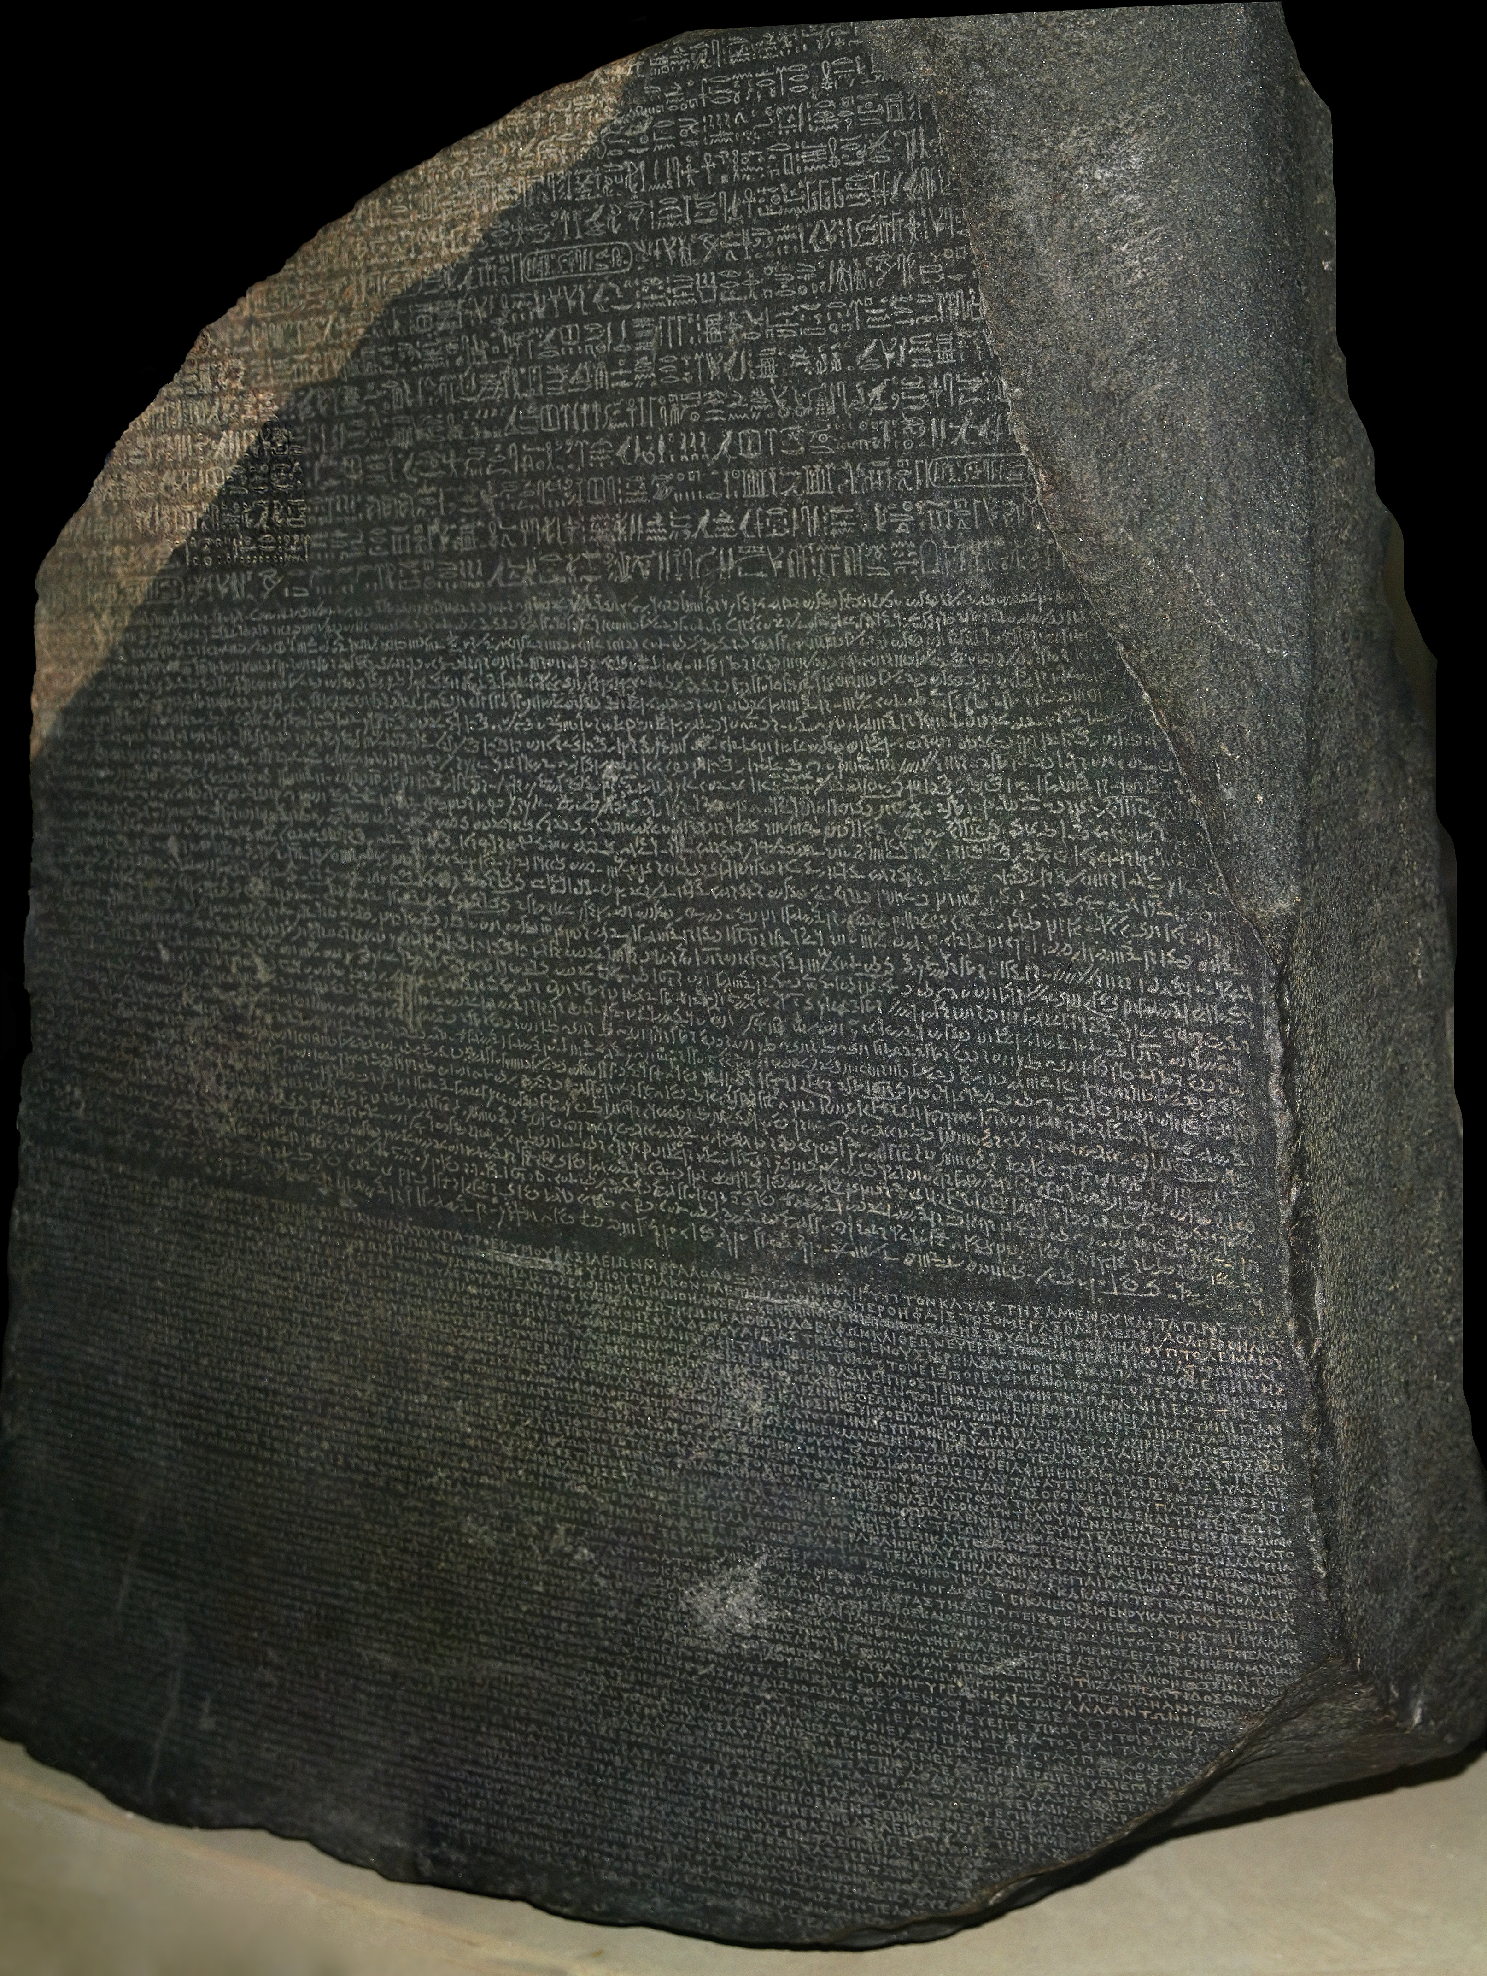
The Rosetta Stone
Uncovered by Napoleon’s troops in 1799 in the Nile Delta near Rosetta, Egypt, this black basalt stone carried an inscription in three scripts – Greek, hieroglyphs, and demotic.
Ceded to Britain in 1801 CE, the Rosetta Stone now resides in the British Museum. In 1822 CE, French Egyptologist Jean- François Champollion decoded its meaning and now, after nearly 2000 years, hieroglyphs can be read once again!

Slide 5
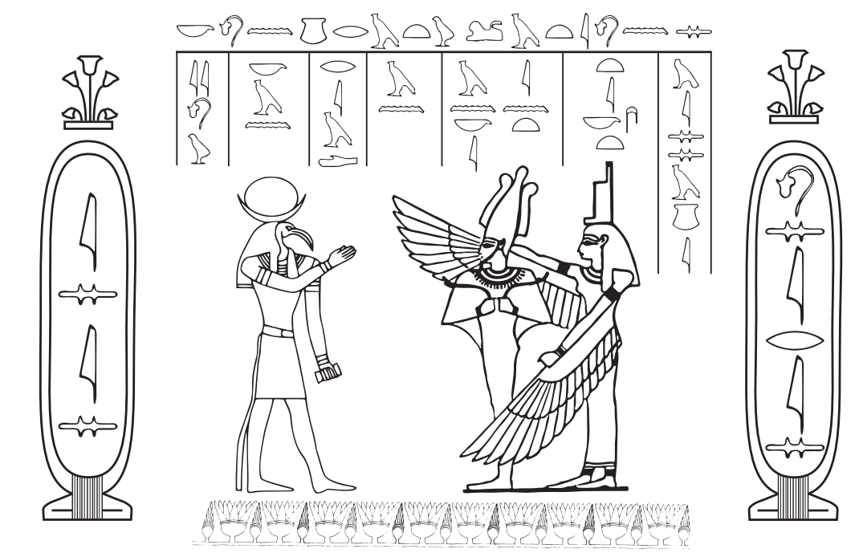
ACTIVITY 1 – Level A: Decode the Writing
Using the alphabet provided, decode the following:
1
Hieroglyphs can be written from left to right, right to left, or top to bottom.
The direction to read is indicated by the way the humans and animals are facing.
Read towards the faces. Often hieroglyphs will be written within registers. These are divided spaces among a text marked off by horizontal or vertical lines.
2
3
4

Slide 6
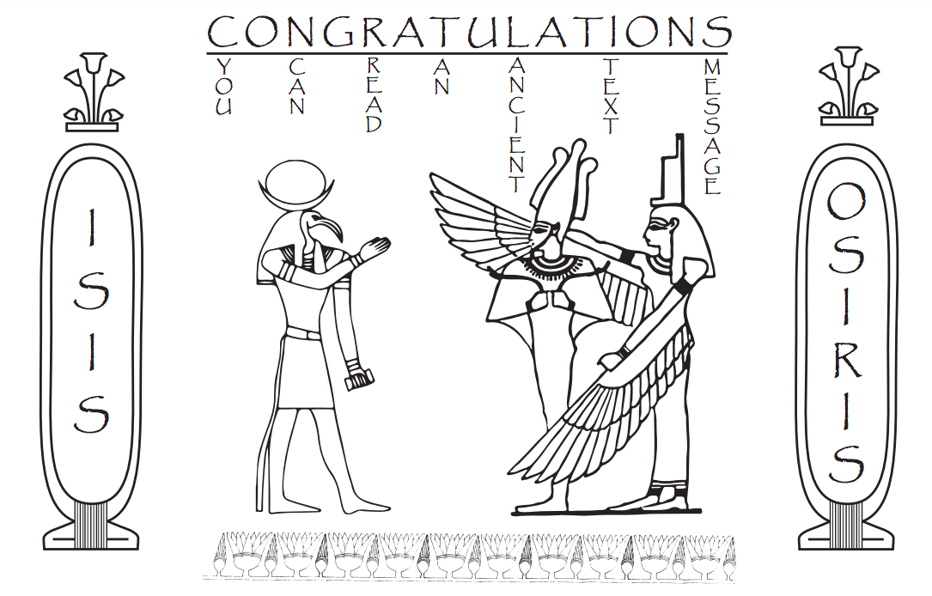

Slide 7
ACTIVITY 2 – Level B: Make a CARTOUCHE
An oval circle with a name written in it, rather like a nameplate.
In the early days of ancient Egypt, a cartouche was attached to the coffins of kings and queens.
As time went on, many people hired an artist to create a cartouche for their own coffins.
The ancient Egyptians believed that you had to have your name written down somewhere, so that you would not disappear when you died.
By attaching a cartouche to their coffin, people made sure their name was written down in one place at least!
INSTRUCTIONS:
Create a Cartouche with your name.
You can write your name as you would in English, letter by letter, or write the letters for just the sounds in your name, eliminating any silent or repeated letters.

